Slide 1
V Soorya Narayanan
311521243052
Final Project
GEN AI
3/21/2024 Annual Review

Slide 2
PROJECT TITLE
Real-Time Transformer Training
With Shakespeare data
3/21/2024 Annual Review

Slide 3


AGENDA
1.PROBLEM STATEMENT
2.PROJECT OVERVIEW
3.WHO ARE THE END USERS
4.SOLUTION AND ITS VALUE PROPOSITION
5.THE WOW IN THE SOLUTION
6.MODELLING
7.RESULT
3/21/2024 Annual Review

Slide 4

PROBLEM STATEMENT
Developing an effective and dynamically adaptable language model for real-time text generation presents a significant challenge. Traditional language models often lack the ability to continuously learn and update their understanding based on new data, hindering their proficiency in generating coherent text, especially in specialized domains like Shakespearean literature.
3/21/2024 Annual Review

Slide 5

PROJECT OVERVIEW
The project aims to address the limitations of existing language models by training a model on a provided text dataset, specifically focusing on Shakespearean works. The primary objective is to create a language model capable of dynamically learning and adapting to new information in real-time, thus improving its ability to generate coherent text consistent with the style and language of Shakespeare.
3/21/2024 Annual Review

Slide 6

WHO ARE THE END USERS?
Literature Enthusiasts
Students and Educators
Creative Writers
Interactive Media Developers
Language and AI Researchers:
3/21/2024 Annual Review

Slide 7

YOUR SOLUTION AND ITS VALUE PROPOSITION
Developing a language model trained on Shakespearean data. It dynamically adapts to new information in real-time, ensuring it consistently generates coherent text in Shakespearean style.
Value Proposition:
Real-Time Adaptation: Our model stays updated with evolving language patterns, delivering relevant text generation.
Authenticity: Trained on Shakespearean works, it reliably produces text consistent with the style and language of the Bard.
Efficiency: Thorough validation ensures its effectiveness across various applications, from literature analysis to creative writing.
Versatility: From literature enthusiasts to creative writers, our model caters to diverse user needs, enhancing text generation experiences.
3/21/2024 Annual Review

Slide 8

THE WOW IN YOUR SOLUTION
A language model trained specifically on Shakespearean data. This model dynamically adapts to new information in real-time, ensuring it consistently delivers text in the authentic style of the Bard.
3/21/2024 Annual Review
8

Slide 9
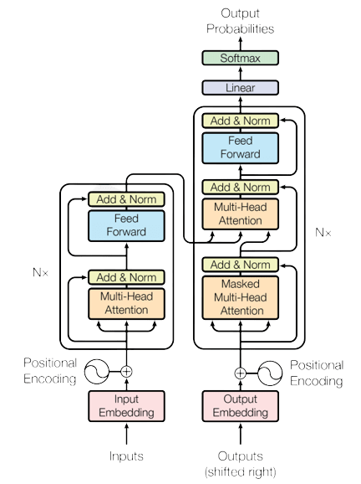
MODELLING
Teams cam add wireframes
Transformer Model:
Self-Attention Mechanism:
The core innovation of the Transformer is the self-attention mechanism, which allows the model to weigh different parts of the input sequence differently when making predictions. This mechanism helps capture long-range dependencies in data.
Encoder-Decoder Structure:
The Transformer is structured as an encoder-decoder model. The encoder processes the input sequence, while the decoder generates the output sequence. Both the encoder and decoder consist of multiple identical layers.
3/21/2024 Annual Review
9

Slide 10
RESULTS
The dynamically adaptable language model, trained on Shakespearean data, offers a versatile solution for generating authentic text in the style of the Bard. With its real-time adaptation capabilities and rigorous validation.
It promises to enhance text generation experiences across various applications, catering to the diverse needs of users in literature, education, creative writing, and beyond.
https://github.com/Dhanushprasana/Real-Time-Generative-Transformer
3/21/2024 Annual Review
10

